Slide 1
Uncovering Main Topics in AIRBNB Reviews LDA and LSA Methods
Group 1
Michael Arons
Malgorzata Klesna-Blat
Jiesen Ou
Wendy Zhai

Slide 2

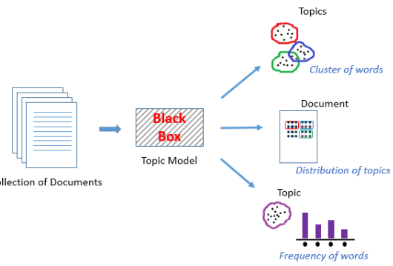


AGENDA
Introduction and EDA
Topic Modeling with SASEM and Python
Delivering Insights
Limitations/Future Use

Slide 3
Introduction and Exploratory Data Analysis

Slide 4
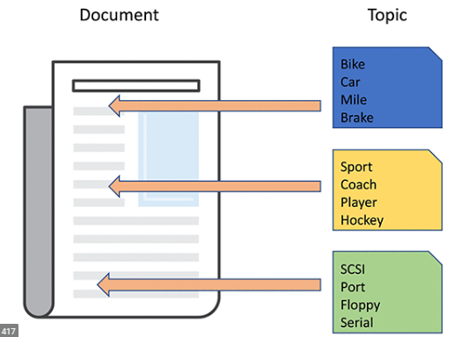


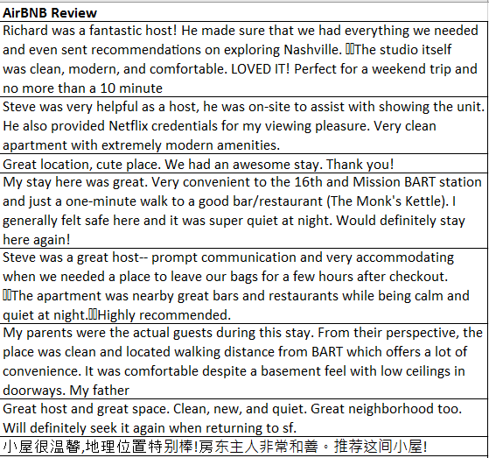
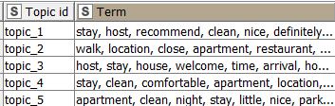
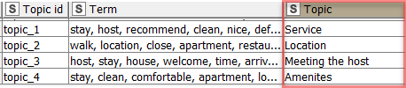
What Is the Plan?
Corpus of Documents
Create Topics from Reviews
Using LSA and LDA
Insights, Answering key Questions
1
2
3
After figuring what the topics are based on the terms we can answer questions such as what do reviewers care about? If you are someone with a listing what should you put in your description to attract customers? And other questions. We can also compare our two different outputs from LSA and LDA

Slide 5
Latent Dirichlet Allocation (LDA)
Latent Semantic
Analysis (LSA)
Unsupervised learning technique
Input: Corpus of documents transformed into Bag of Words in a matrix format
Topics are created by generative probabilistic model
Output: A group of topics with keywords and weights assigned to each document and how aligned the document is to each topic
Unsupervised learning technique
Input: Corpus of documents transformed into Bag of Words in a matrix format
Topics are created by dimension reduction using SVD
Output: A group of topics with keywords and weights assigned to each document and how aligned the document is to each topic

Slide 6
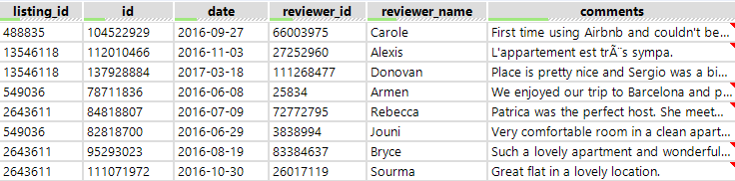
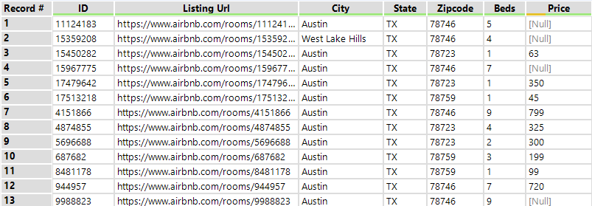
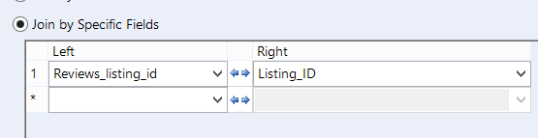
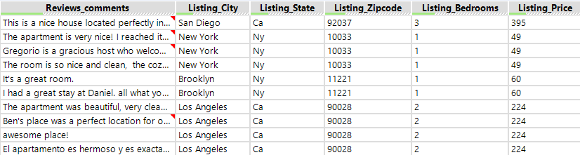
AirBNB Review Data
Reviews Data
Listing Data

Slide 7
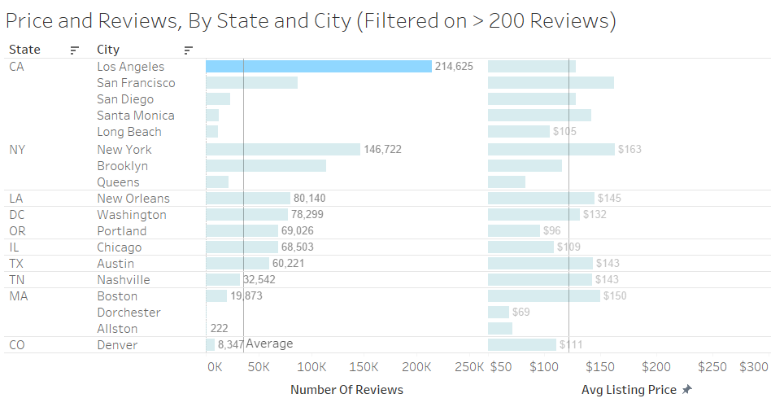
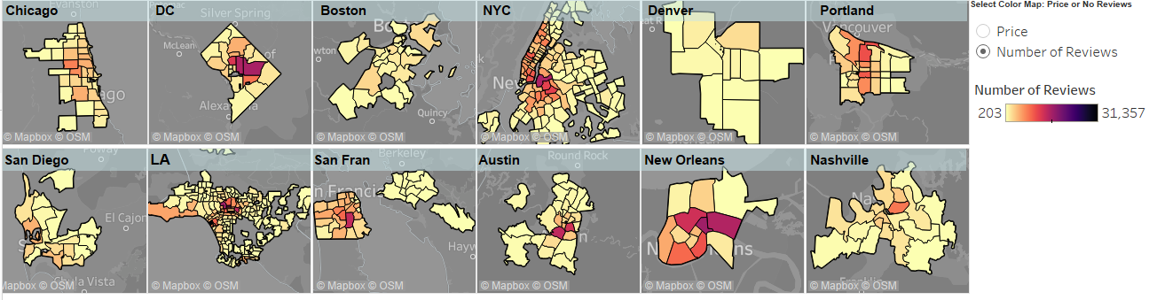
Where Are AIRBNB Reviews Coming From?
NYC accounts for over 20% of total reviews in our dataset.
Los Angeles and New York City account for over 34% of total reviews in our dataset
We notice that for each of the main areas as we get closer to the city center the number of reviews increase greatly.
Also, we notice that the number of reviews is very concentrated in a few key zip codes (especially LA and NYC)

Slide 8
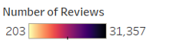
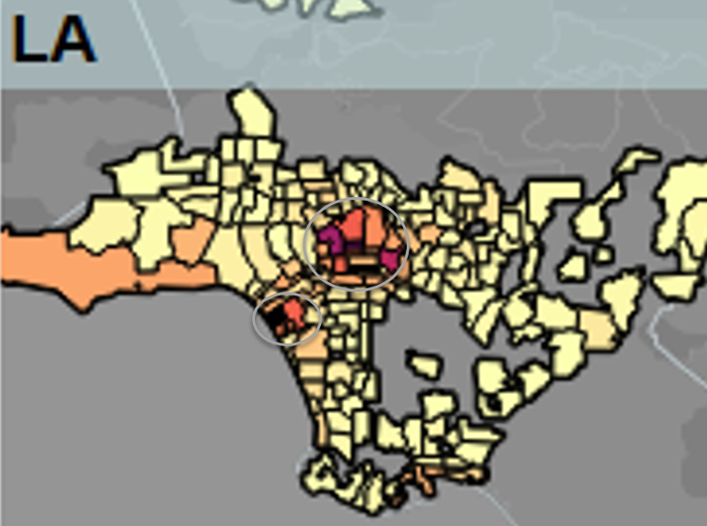
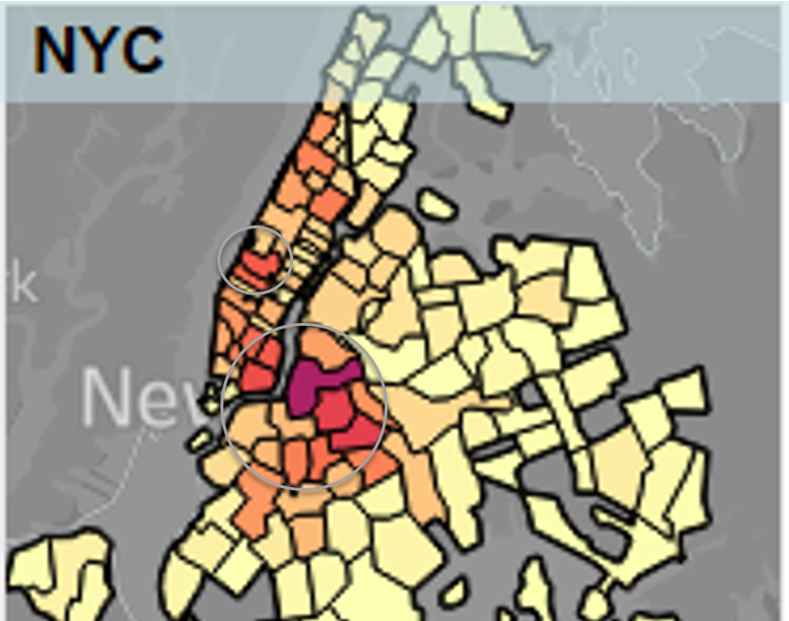
Number of Reviews zoomed in for NYC and LA provides a closer look at reviews in the top two cities in the dataset.
The darker the color of the area, the greater the number of reviews for that zip code in the dataset.
LA has 2 very dark spots indicating a very high number of reviews in these neighborhoods
NYC has several neighborhoods with a high number of reviews

Slide 9
Topic Modeling with SASEM and Python

Slide 10
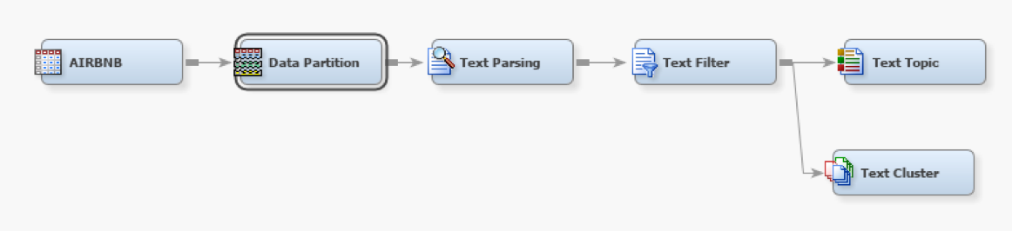
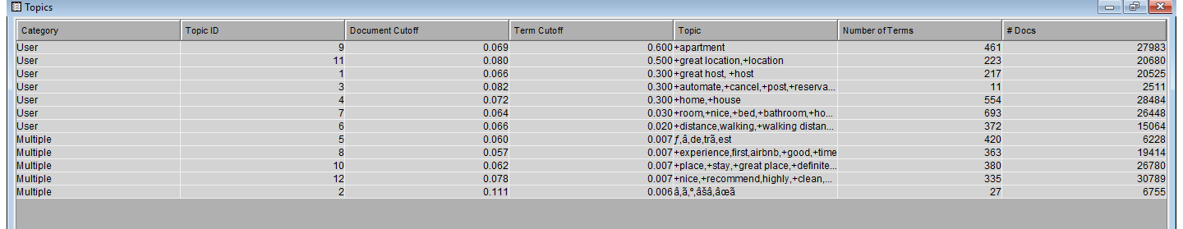
Topic Modeling with LSA
Data: review_comments;
127,158 rows
The challenge with SVD: hard to determine the optimal number of dimensions.
Apartment
Location
Host
Service
Home/house
Room
Distance
Foreign language1
Airbnb experience
Place/ stay
Nice/recommend
Foreign language 2

Slide 11
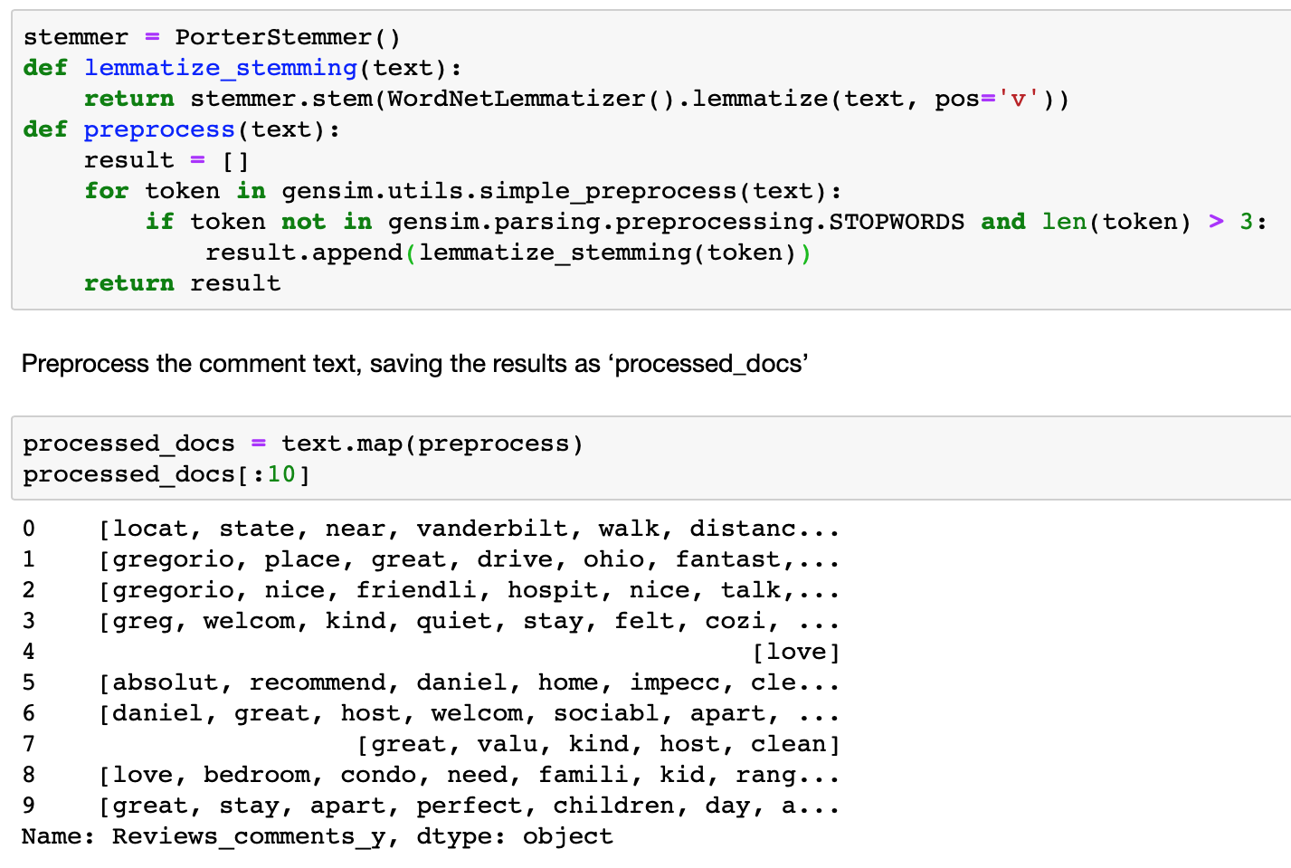
Topic Modeling with LDA
Data Pre-Processing
Tokenization
Words that have fewer than 3 characters are removed
All stopwords are removed
Words are lemmatized and stemmed
Loading gensim and nltk libraries

Slide 12
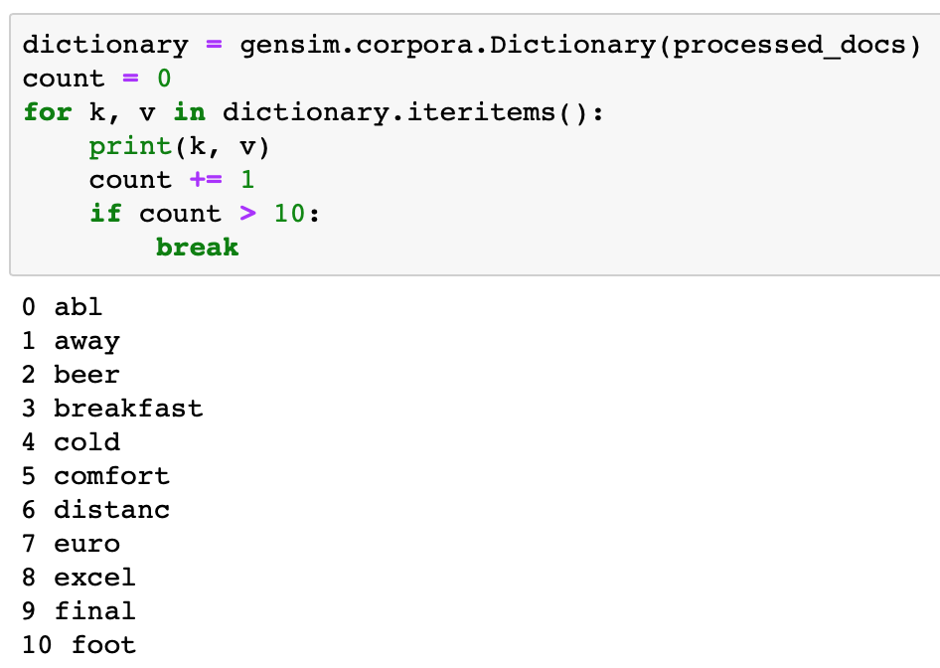
Topic Modeling with LDA
Bag of Words on the Data set
Pre-process the comment text, saving the results as ‘processed_docs’
Create a dictionary from ‘processed_docs’ containing normalized words and their integer ids

Slide 13
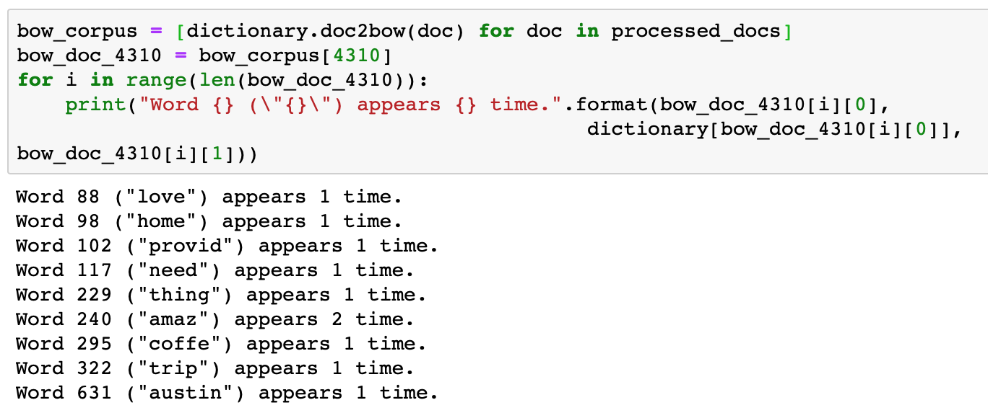
Topic Modeling with LDA
Gensim filter_extremes and doc2bow
Filter out tokens that appear in:
less than 15 documents or
more than 30% documents
keep only the first 100,000 most frequent tokens
For each document, create a dictionary reporting how many words and how many times those words appear.
Then check the document selected earlier.

Slide 14
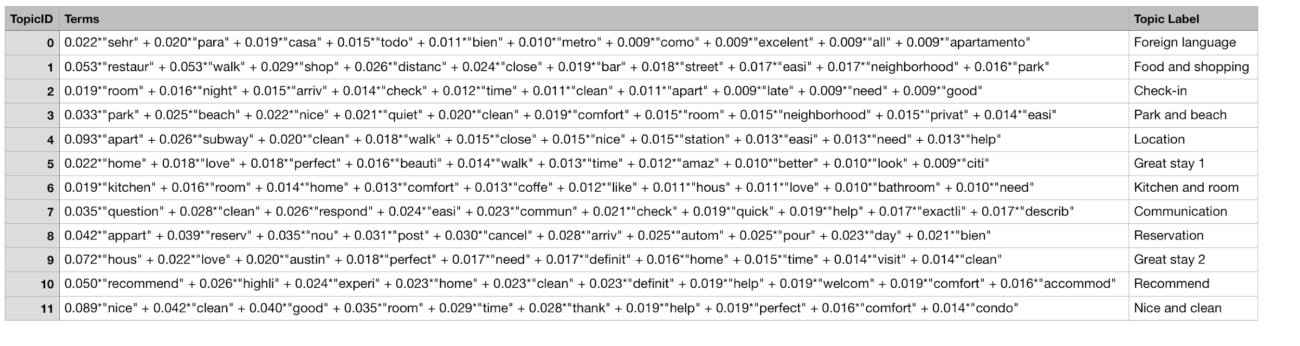
Topic Modeling with LDA
Running LDA using Bag of Words
Train the LDA model using gensim.models.LdaMulticore and save it to ‘lda_model’.
Let the number of topics equal 12.

Slide 15
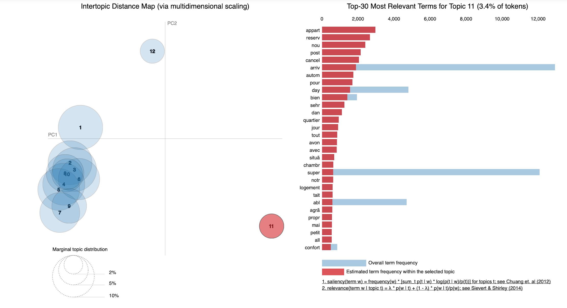
Topic Modeling with LDA
Visualization
pyLDAvis allows for data visualization in an interactive format.
Left: a plot of the "distance" between all of the topics.
The relative size of a topic's circle corresponds to the relative frequency of the topic in the corpus.
Right: a bar chart showing top terms.

Slide 16
Takeaways and Insights

Slide 17
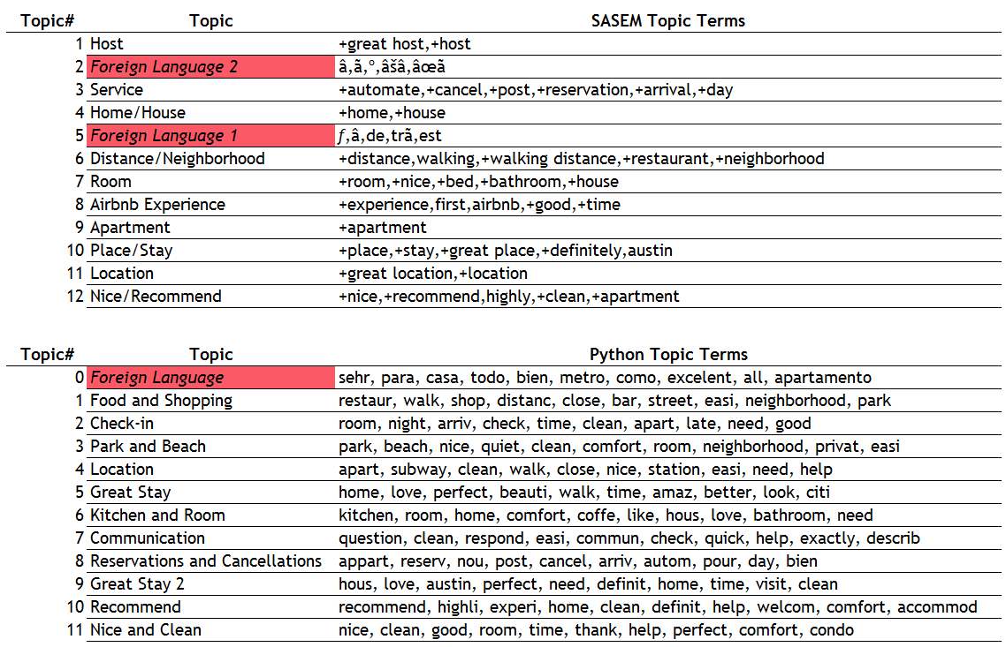

Slide 18
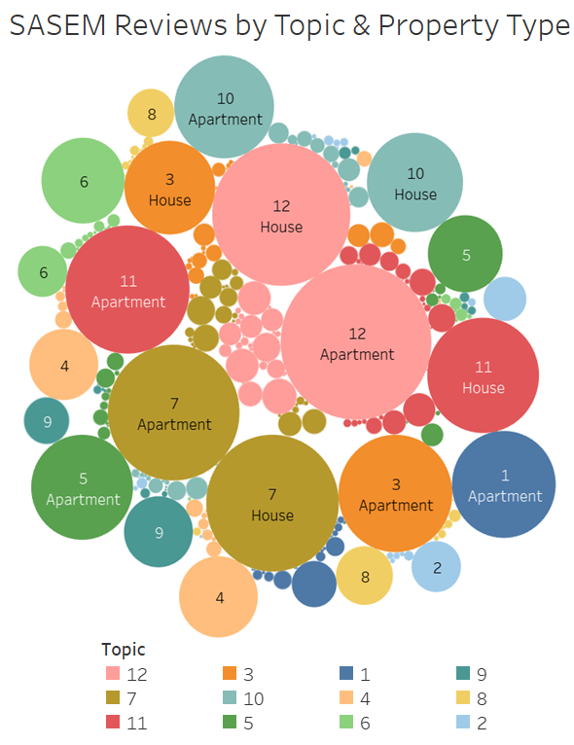
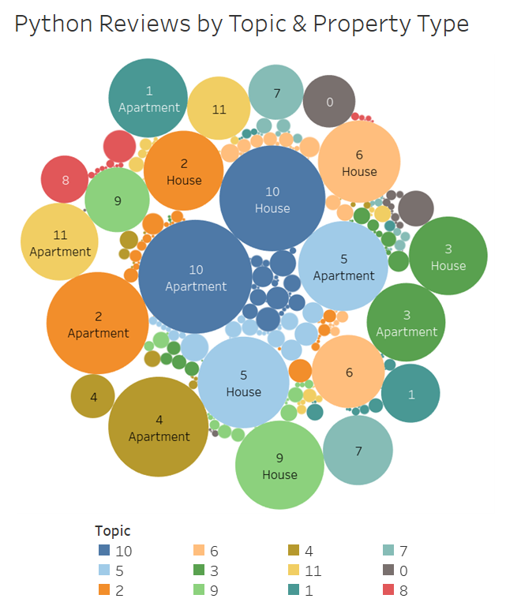
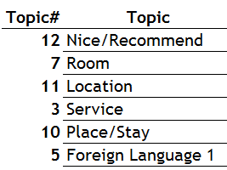
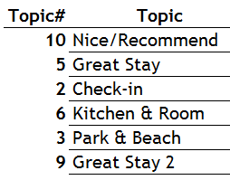

Slide 19

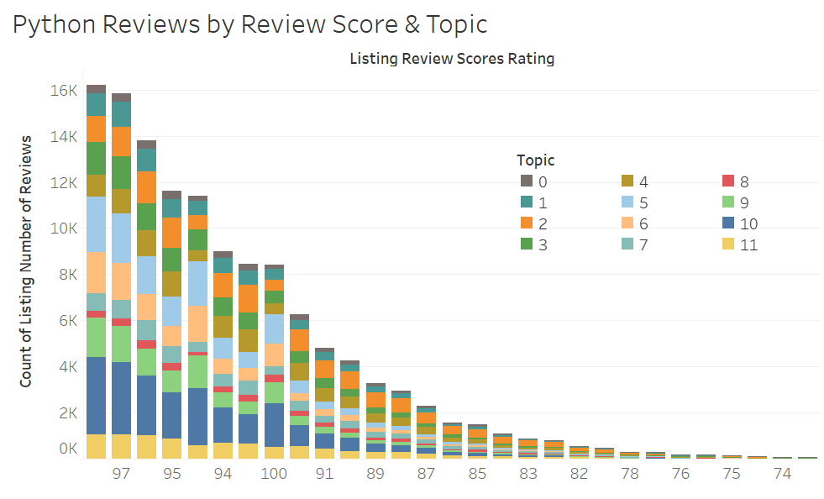
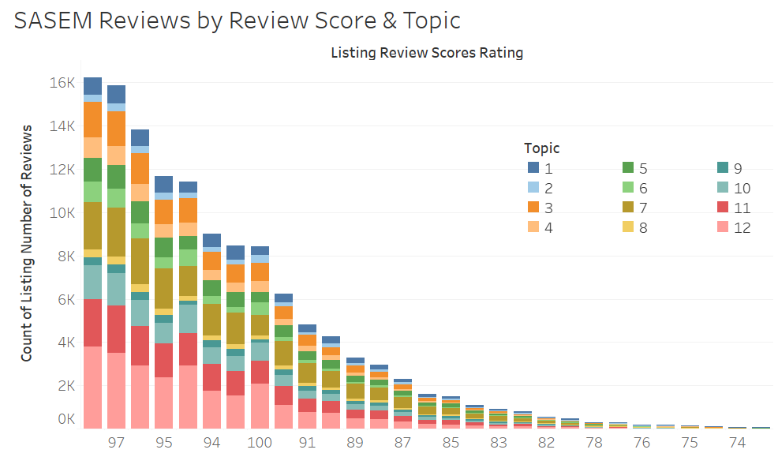
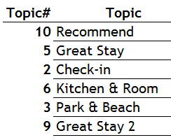

Slide 20
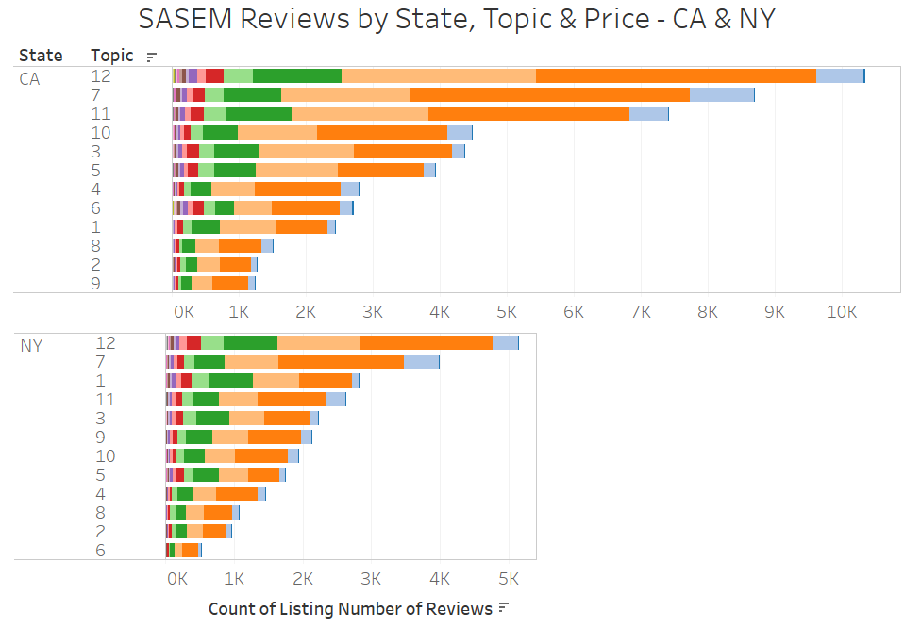
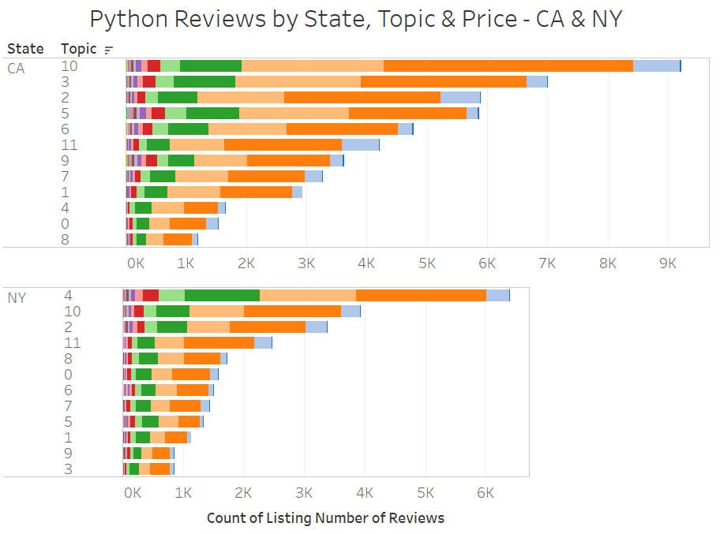
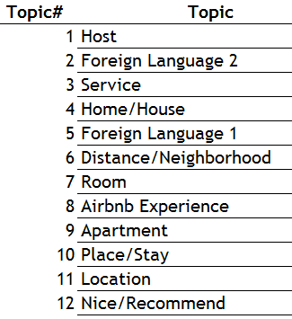
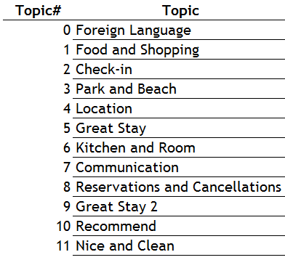
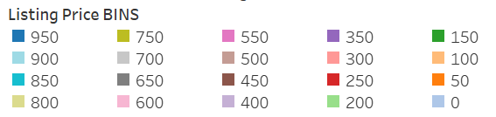

Slide 21
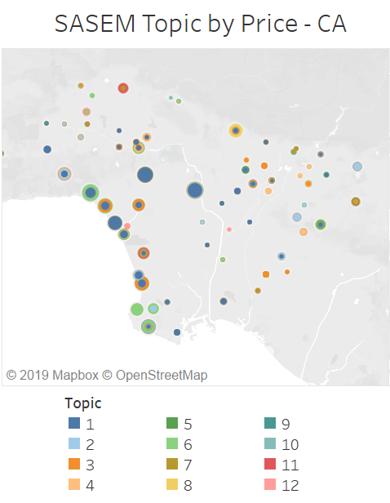
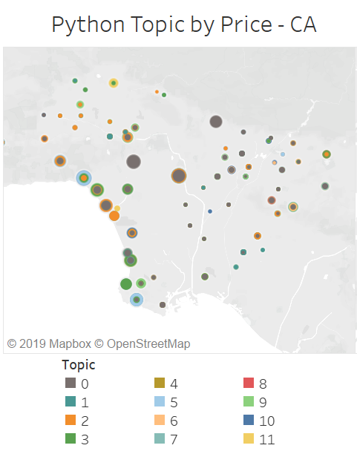
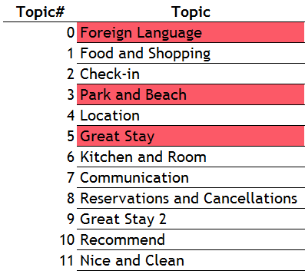
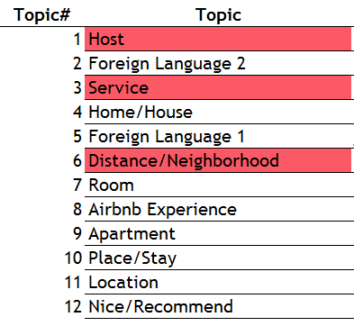
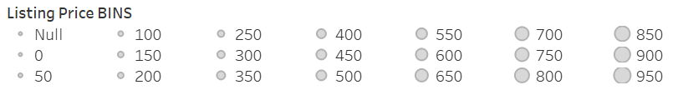

Slide 22
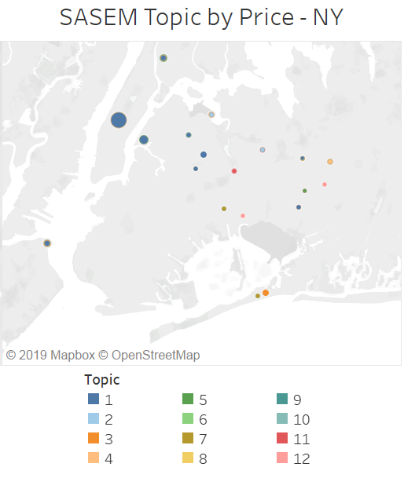
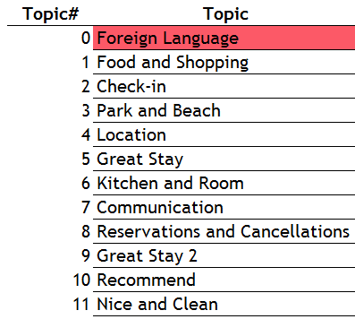
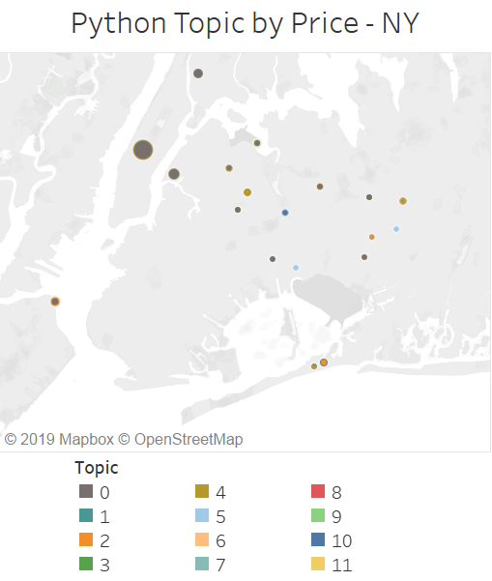
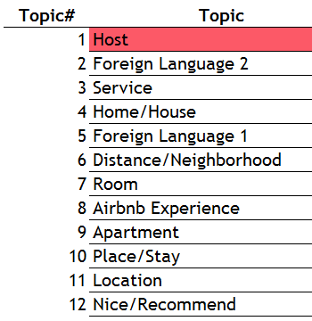

Slide 23
Limitations and Future Use

Slide 24


Limitations
Software: SASEM can only take a proportion of data
Under-reporting: Survival bias for listings
Dictionary: Words alone do not provide adequate information
Meaning: ‘Apple’ is different from ‘Apple’
Context: ‘Recommend’ is one of common words used in NEGATIVE reviews
More than words: Emoji 一 :-) :>) XD ( ﾟ∀ ﾟ)

Slide 25
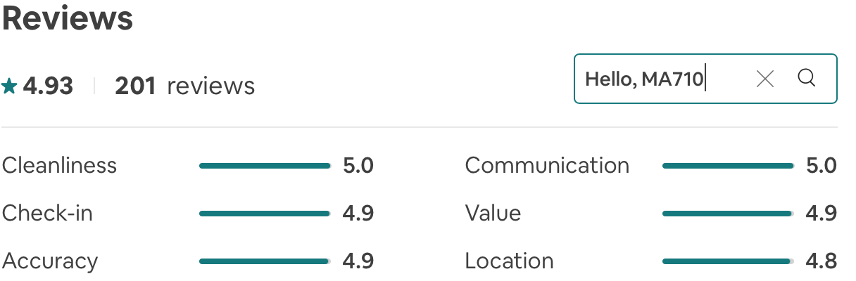

For the Future
Customers & Owners
Streamline searching process
Sentiment analysis to uncover true customers’ demand
ANOVA and hypothesis test to find connections among topics
Prediction for price based on topics as predictors
US
Data mining is a subject of art & science
Human analysis still necessary

Slide 26
THANK YOU!

Slide 27
APPENDIX

Slide 28
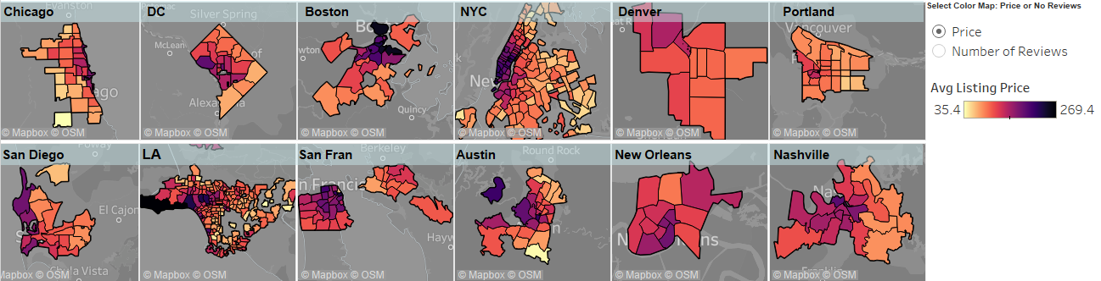
Reviews and Average Price by Zip Code
We notice that for each of the main areas as we get closer to the city center number of reviews increases greatly.
Also, we notice that the number of reviews is very concentrated in a few key zip codes (especially in LA and NYC).
We notice some very dark spots in LA in Malibu, Boston (seaport areas) and some areas in NYC indicating very expensive listings.
We also notice again that moving away from the center of the city usually results in lower costs, especially in NYC and Chicago.

Slide 29
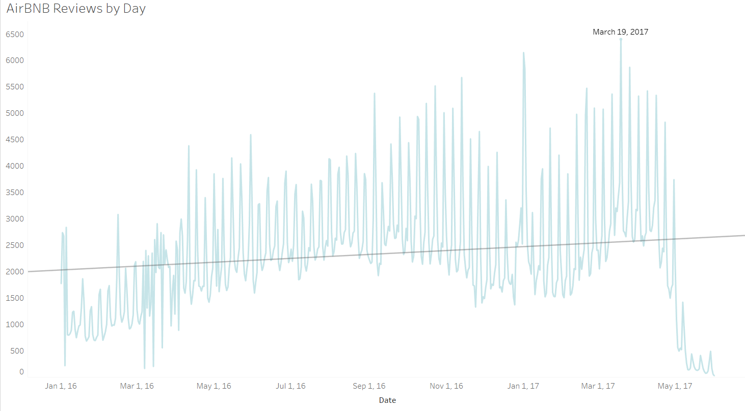
Reviews by day indicate a cyclical pattern where the first 2 months and the last month have a huge drop off. We examine reviews by day and month to further investigate the cyclical nature of the number of reviews.
Reviews by Day

Slide 30
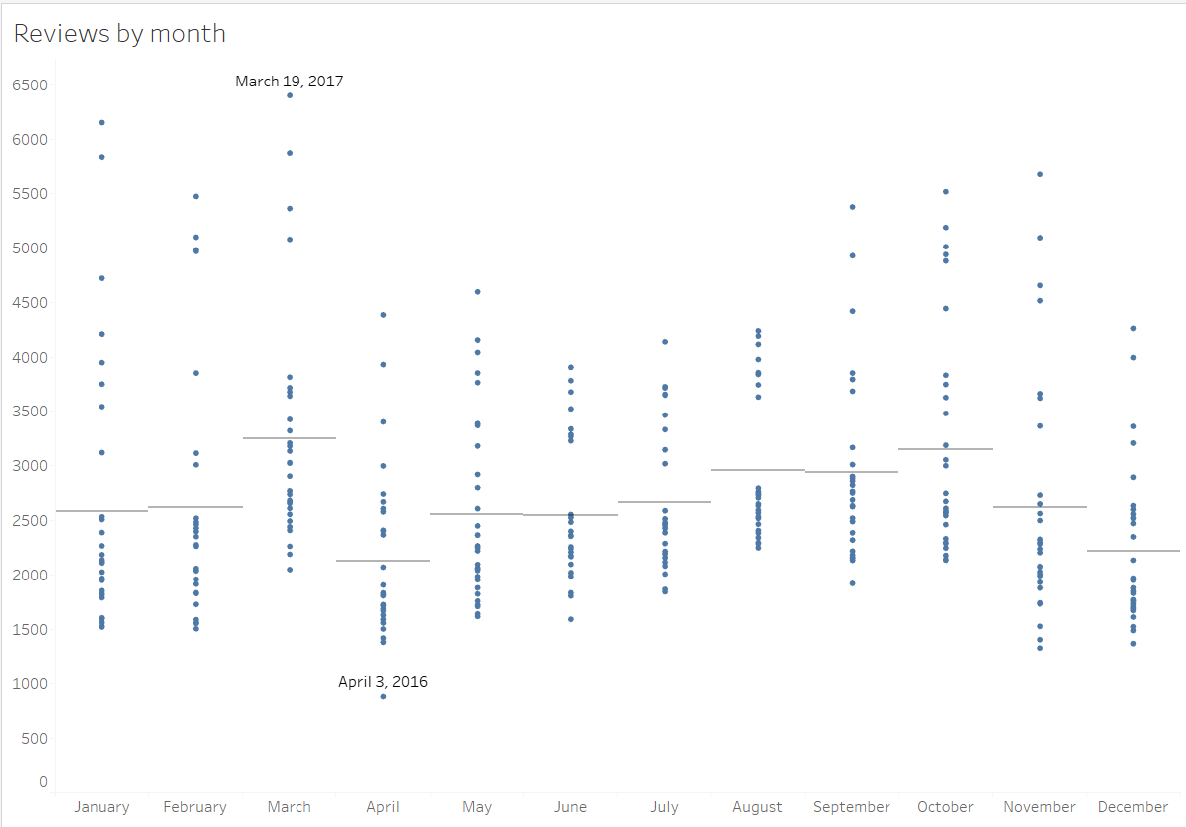
Reviews by Day – cont.

Slide 31
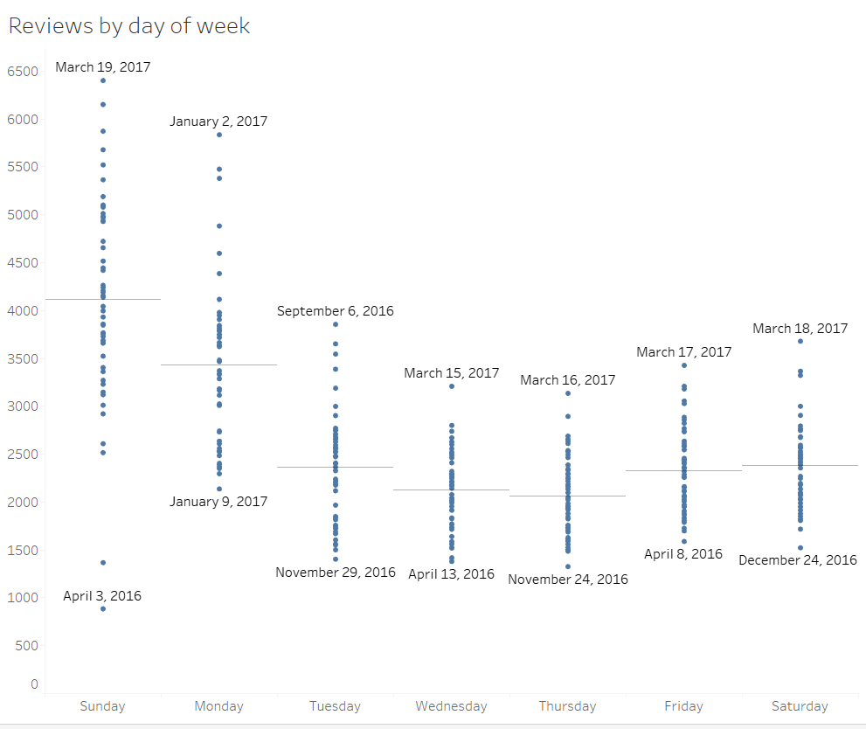
The cyclical nature seems to be largely contributed to the days of the week people submit reviews. It makes sense that people stay at an AirBNB on the weekend, and will submit a review on the Sunday or Monday after finishing the trip. Here, we filter on the date range Apr 1, 2016 – Mar 31, 2017 because of the drop in number of reviews in the first couple months and last month.
Reviews by Day – cont.

